Slide 1
HireAC
YOUR HOW TO GUIDE

Slide 2
HireAC Guide Sections
Getting Started with HireAC
Cooperative Education Module in HireAC
Changing Preferred Name in HireAC
Downloading the Co-op Work Permit Confirmation Letter
Co-op Documents Page in HireAC
Co-op Job Postings Page in HireAC
Setting up Job Alerts in HireAC
Co-op Interviews Page in HireAC
Co-op Job Offers in HireAC
Co-op Work-term record in HireAC
Booking a Peer Review meeting in HireAC
Events And Workshops Module in HireAC
Career & Employment Module in HireAC

Slide 3
6. Co-op Job Postings Page in HireAC
Where to find and how to navigate the Co-op job posting listings in HireAC
How to review and apply for Co-op jobs in HireAC

Slide 4
2. How to review and apply for Co-op jobs in HireAC

Slide 5
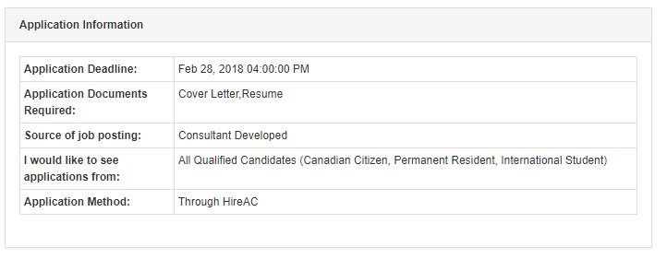
Viewing and Applying for Co-op Jobs
On the Search Results page, you will see the jobs with the job posting title, company name, location, and deadline dates
Click on the Job Title name to view the entire job description
Read over the job description. If you want to apply to the position, review and follow the Application Information details. In HireAC you can apply for jobs through: HireAC itself or the Employer Website.

Slide 6
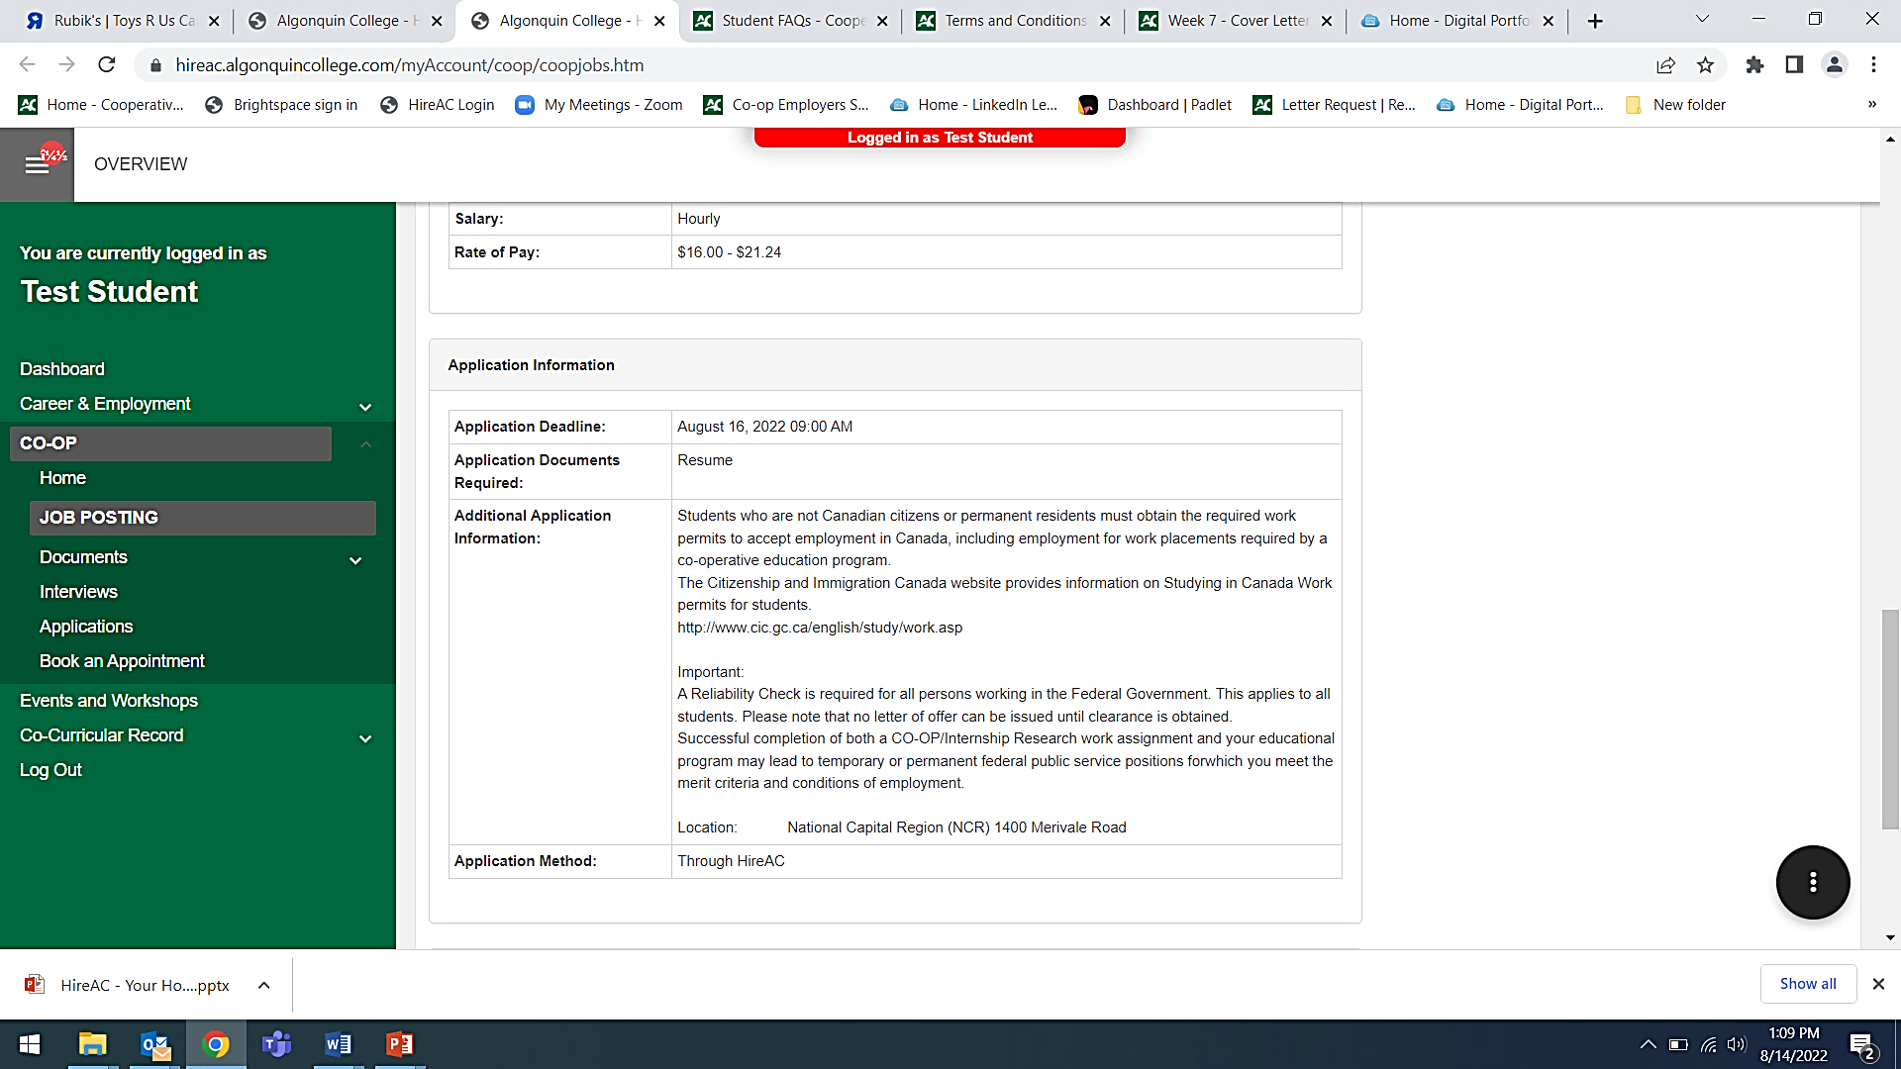
Applying for Co-op jobs through HireAC
You will create an Application Package in HireAC with the required application documents.
In the Application Information section, you can find out what documents the employer requested for student applications.
HireAC is set up in a way that you must have the requested documents in your package to apply for that opportunity
Please note: HireAC does not have a section to upload a transcript or a portfolio.
If a transcript or a portfolio is requested as part of your application, please include them as an additional page(s) to your resume or by adding a URL link in your resume header.

Slide 7
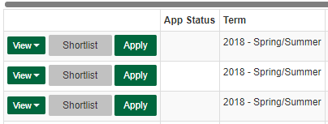
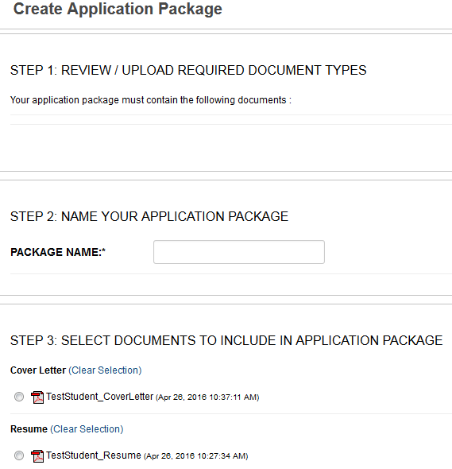
Creating an Application Package in HireAC
A separate package is required for each job application!
Within a position in HireAC select Apply on the left-hand side of the screen.
On the next screen, follow the steps to creating the Application Package.
You may have to scroll down to see these steps
Name the Package.
Select/upload the required documents.
Confirm Package, it will appear at the top of the page.
Click Apply beside the application you created.
1
2
3
4

Slide 8
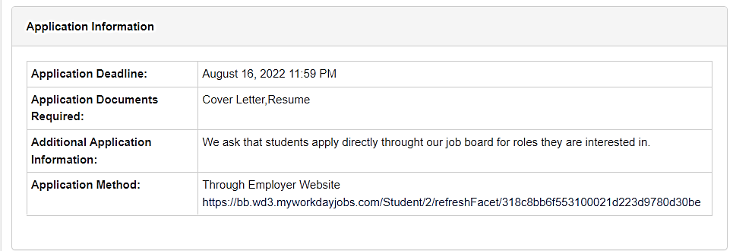
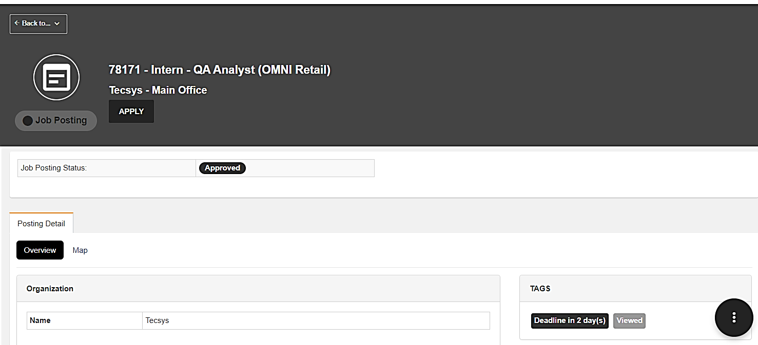
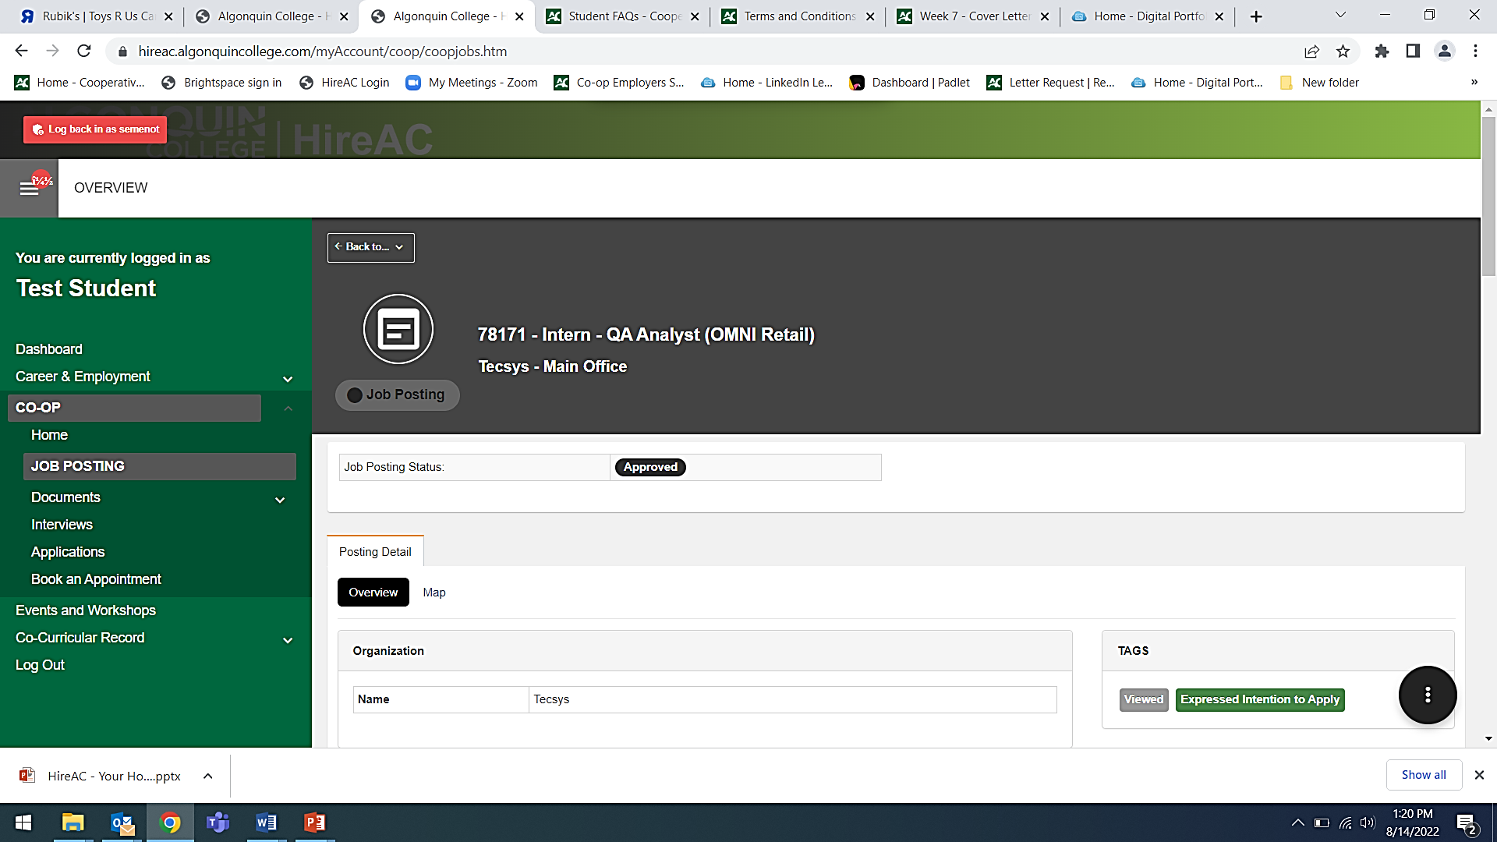
Applying for jobs through the Employer Website
In some cases, employers will ask that you apply on their website. This will require you to also complete an Application Form online on the employer’s website.
In the Application Information section, you can find out what documents you need to apply
Click on the Apply button under the job posting information at the top of the page to follow the application link and to track your application in HireAC.
1
2

Slide 9
Important Notes on Job Applications in HireAC
Before proceeding with your job applications, please read the job descriptions carefully to fully understand the job responsibilities and qualifications required by the employer, and be sure to customize your resume and cover letter to the job posting requirements and employer needs.
Co-op jobs that require applications through HireAC
Employers will not be able to view student submissions until after the closing date.
You may cancel, update and resubmit your application any time before the deadline.
Once the deadline passes, employers will receive an application bundle for review, and the system will not accept further submissions.
Co-op jobs that require applications through the Employer Website
The application deadline is set and managed by the employer.
You may need to create an account with that employer to submit your job application. Follow the steps indicated by the employer to create and submit your job applications.
Use the Apply button to follow the application link and track the job in your HireAC record.

